Slide 1


Introduction
Meet Alsamad Shaikh, a dedicated student in BCA III.
Name
Roll Number
Class
Alsamad Shaikh
28
BCA III

Slide 2
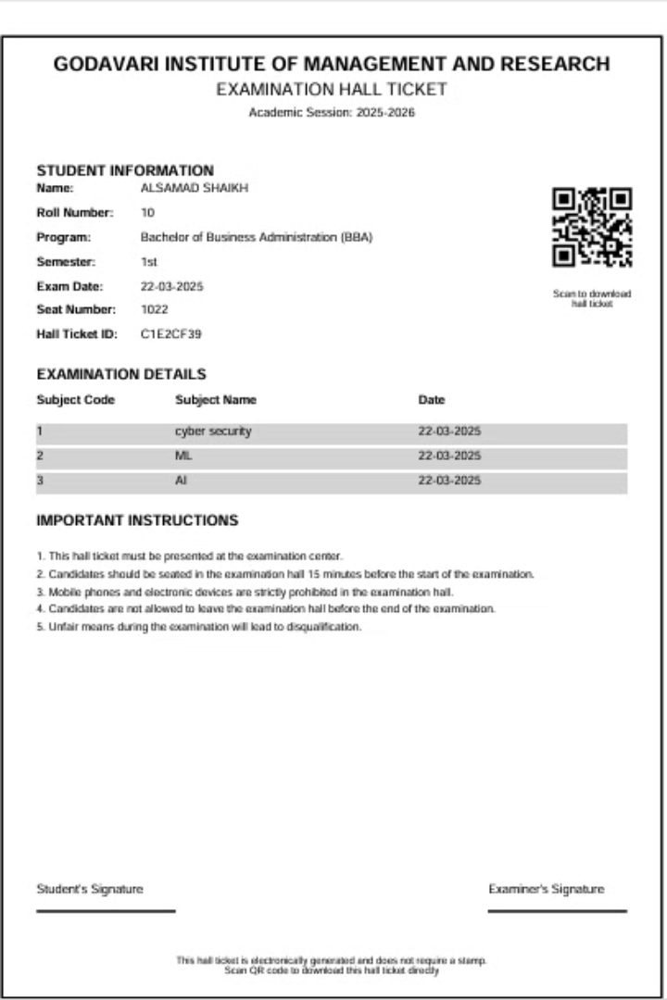
Hall Ticket Generation System with QR Code
This project report details the development of a Hall Ticket Generation System with Integrated QR Code, designed for Godavari Institute of Management and Research. The system automates the creation, management, and distribution of examination hall tickets, replacing traditional manual methods with a digital solution that integrates QR codes for enhanced security and convenience.
The system leverages Python, Streamlit, and other open-source technologies to streamline the hall ticket process, reduce administrative overhead, and enhance security through QR code verification.

Slide 3
System Objectives and Automation
Automation
Security
Efficiency
Automate hall ticket generation, eliminating manual creation and reducing administrative workload.
Use QR codes to verify authenticity and prevent counterfeiting, enhancing security and reducing fraudulent tickets.
Reduce administrative workload through dynamic generation and digital distribution of hall tickets.
The primary objectives of the system are to automate the entire process of hall ticket generation, enhance security through QR codes, and improve efficiency by reducing administrative workload. The system supports large-scale examinations with a modular design adaptable to diverse user requirements.

Slide 4
Addressing the Need for Digitization
Manual Errors
Resource Intensive
Security Risks
Traditional manual processes are labor-intensive and prone to errors in critical information.
Distribution of physical hall tickets presents logistical challenges and issues with lost documents.
Physical tickets are vulnerable to loss, theft, or forgery, compromising examination integrity.
Traditional hall ticket systems face numerous challenges, including manual errors, resource intensiveness, and security risks. This project addresses these limitations by digitizing processes, integrating QR codes for instant verification, and enabling on-demand ticket generation, minimizing waste and enabling real-time updates.

Slide 5
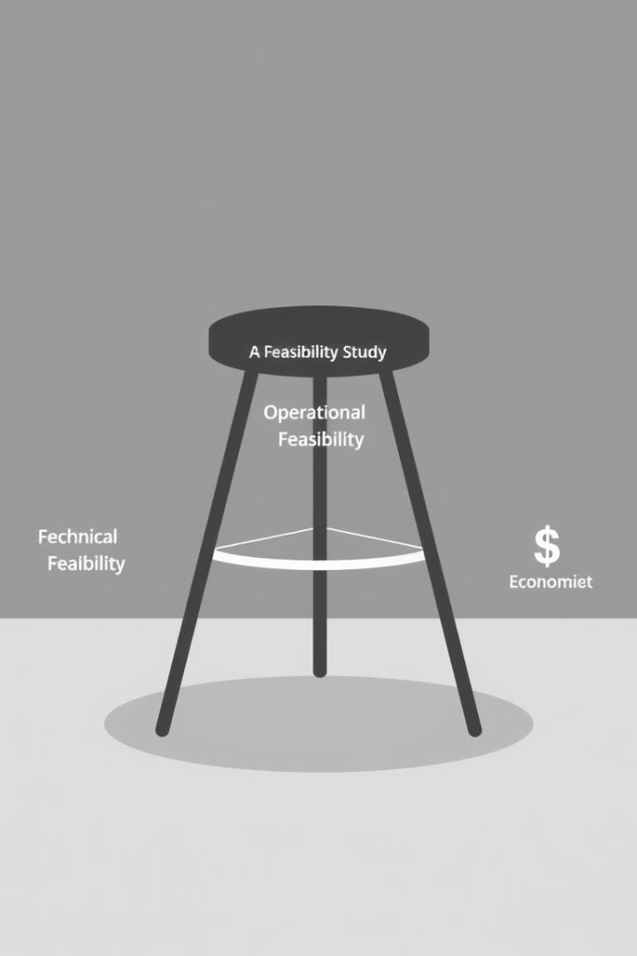



Feasibility Analysis
Technical
Operational
Economic
Utilizes mainstream technologies like Python, Streamlit, and pandas, ensuring reliability and community support.
Integrates smoothly with existing procedures, requiring minimal training for administrative staff.
Minimizes development costs by leveraging open-source technologies and reducing operational expenses.
The system's feasibility is evaluated across technical, operational, and economic dimensions. The system utilizes mainstream technologies with robust community support. The intuitive Streamlit interface requires minimal training for administrative staff, ensuring rapid adoption. Open-source tools reduce licensing costs, and the system avoids physical infrastructure expenses.

Slide 6
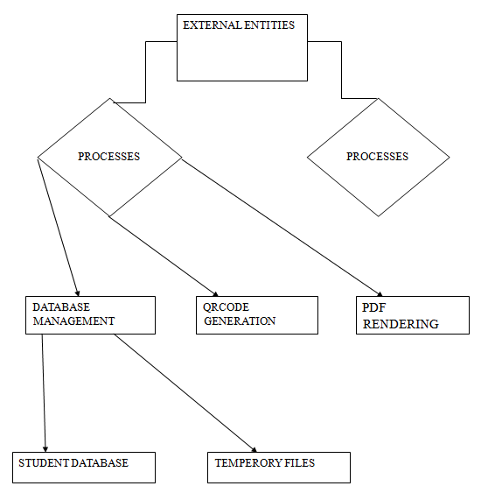
DFD :

Slide 7
System Design and Database
Data Input
1
Administrators enter student details into a web interface.
QR Generation
2
Unique QR codes are generated using the qrcode library.
PDF Generation
3
ReportLab constructs a PDF hall ticket, embedding the QR code and student details.
The system employs a structured algorithmic workflow to ensure efficiency and accuracy. The CSV database schema includes columns for student ID, name, roll number, program, semester, exam date, seat number, hall ticket ID, and subjects. The system checks for duplicate entries and saves valid records in a CSV database.

Slide 8
Software and Hardware Specifications
Hardware
Software
Processor: 1.6 GHz dual-core or higher
Streamlit: Web interface
RAM: Minimum 4GB (8GB recommended)
pandas: Data management
Storage: At least 100MB
qrcode & PIL: QR code generation
Display: 1366x760 or higher
ReportLab: PDF generation
Network: Internet connectivity
The system requires specific hardware and software components to function effectively. Required libraries include Streamlit, pandas, qrcode, PIL, ReportLab, uuid, tempfile, Path, and base64. Python serves as the foundation of the entire system, chosen for its readability, extensive library ecosystem, and cross-platform compatibility.

Slide 9




Strengths and Limitations
Automation
QR Security
1
Reduces manual effort in ticket generation and distribution.
Minimizes fraud and ensures data authenticity.
2
User Design
4
Scalability
Streamlined interface for administrators and students.
3
Adaptable to growing user bases and diverse examination formats.
The system's strengths include automation, QR code security, scalability, and user-centric design.
Limitations include :
Dependency on QR scanners, temporary storage, database security, and limited error recovery. Future scope includes mobile app integration, biometric verification, cloud database migration, and automated notifications.

Slide 10
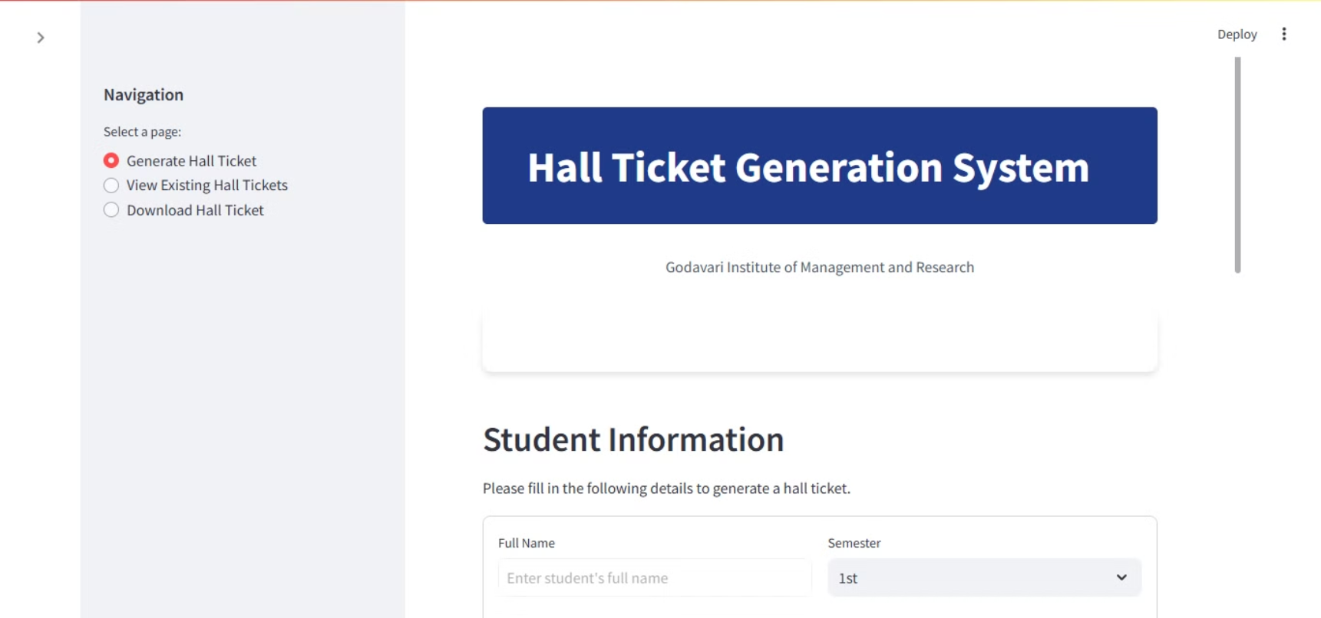
output\snapshot

Slide 11
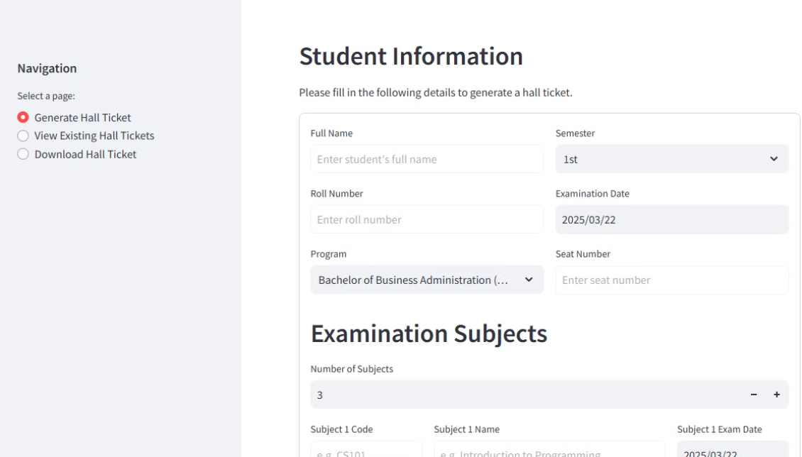

Slide 12
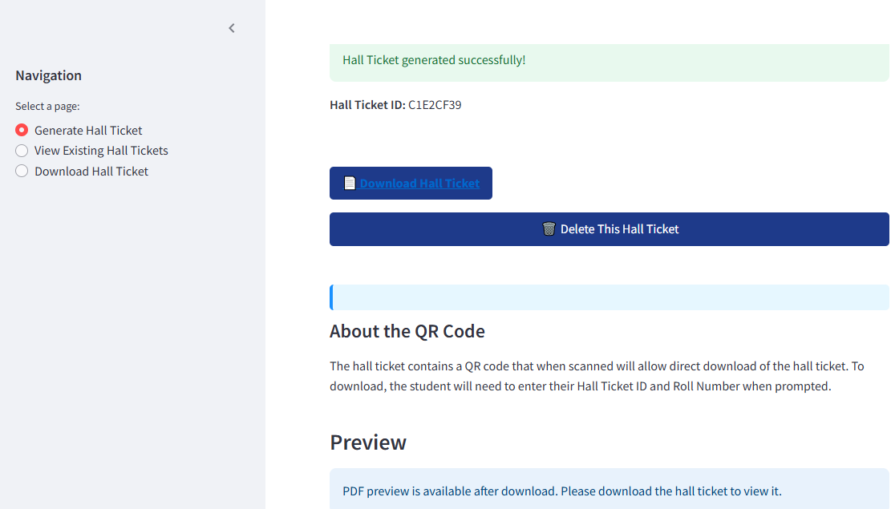

Slide 13




Conclusion and Future Enhancements
Mobile App
Develop a dedicated app for ticket storage and offline access.
Biometrics
Enhance security with fingerprint or facial recognition.
Cloud DB
Migrate to MySQL/PostgreSQL for enhanced scalability and security.
Alerts
Send SMS/email alerts for ticket generation.

Slide 14
Conclusion
The Hall Ticket Generation System represents a significant advancement in examination management, transforming a traditionally labor-intensive process into an efficient, automated solution. The project successfully addresses the core challenges of hall ticket management through automation that reduces workload, minimizes errors, improves accessibility, and enhances the overall examination process.

Slide 15
THANK YOU
NAME : ALSAMAD SHAIKH
CLASS : BCA III
EMAIL : skalsamad@gmail.com

